Slide 1
Machine Learning
Lesson 8: Ensemble Learning

Slide 2

Ensemble Learning
Bagging and Boosting Algorithms
Model Selection
Cross-validation

Slide 3
By the end of this lesson, you will be able to:
Explain ensemble learning
Evaluate performance of boosting models

Slide 4
Ensemble Learning
Topic 1: Overview

Slide 5
Definition
Ensemble techniques combine individual models together to improve the stability and predictive power of the model
Notes:
Trainer Notes: Explain the following:
1. Need for ensemble models

Slide 6

Ideology
Certain models do well in modeling one aspect of the data, while others do well in modeling another
Instead of learning a single complex model, learn several simple models
and combine their output to produce the final decision
In ensemble learning, other models strength performs offset on individual model variances and biases
Ensemble learning will provide a composite prediction where the final accuracy is better than the accuracy of individual models
Notes:
Trainer Notes:
1. Explain the Ideology behind ensemble models

Slide 7
Working
Inputs
Model 1
Ensemble model
Predictions
Model 2
Model 3

Slide 8


Significance
Robustness
Accuracy
Ensemble models incorporate the predictions from all the base learners
Ensemble models deliver accurate predictions and have improved performances
01
02

Slide 9
Ensemble Learning Methods
Techniques to create an Ensemble model
Combine all “weak” learners to form an ensemble
OR
Create an ensemble of well-chosen strong and diverse models

Slide 10
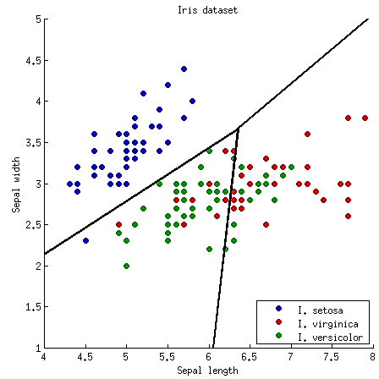
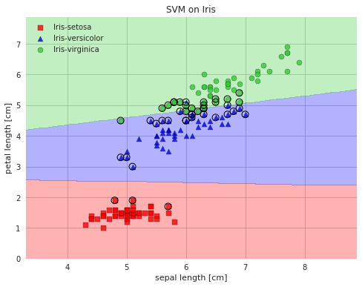
Averaging
50
[50, 0, 0]
setosa
True
petal width ≤ 0.8
150
[50, 50, 50]
setosa
54
[0, 49, 5]
versicolor
False
Petal width ≤ 1.75
100
[0, 50, 50]
versicolor
46
[0, 1, 45]
virginica
Decision Tree
Logistic Regression
SVM
p1 + p2 + p3
P =
3
Equal weights are assigned to different models
Notes:
Trainer Notes: Explain the following:
1. When to use Averaging
2. Advantages and disadvantages of averaging

Slide 11
Weighted Averaging
50
[50, 0, 0]
setosa
True
petal width ≤ 0.8
150
[50, 50, 50]
setosa
54
[0, 49, 5]
versicolor
False
Petal width ≤ 1.75
100
[0, 50, 50]
versicolor
46
[0, 1, 45]
virginica
Decision Tree
Logistic Regression
SVM
50
35
15
Each model is assigned a different weight
w1 + w2 + w3 = 1
P = w1 * p1 + w2 * p2 + w3 * p3
Notes:
Trainer Notes: Explain the following:
1. When to use Weighted averaging
2. Advantages and disadvantages of Weighted averaging

Slide 12
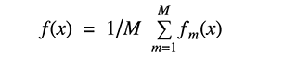
Bagging
Bagging or bootstrap aggregation reduces variance of an estimate by taking mean of multiple estimates
Original
Training data
D
STEP 1
Create randomly sampled datasets of the original
training data ( bootstrapping )
….
D1
D2
D_{t-1}
D_{t}
Resamples
STEP 2
Build and fit several classifiers
to each of these diverse copies
Models
C1
C2
C_{t-1}
C_{t}
STEP 3
Take the average of all the predictions
to make final overall prediction
C*
Notes:
Trainer Notes:
1. Explain the bagging process

Slide 13
Boosting
Boosting reduces bias by training weak learners sequentially, each trying to correct its predecessor
headache, stomach
pain, and leg hurts
headache is surely caused by
X , but cannot explain others
stomach pain and leg hurts
(headache because of X)
agree for X, leg hurts because of
Y, but cannot explain stomach pain

Slide 14
Boosting (Contd.)
headache is surely caused by X , but cannot explain others
agree for X, leg hurts because of Y, cannot explain stomach pain
agree on X, sort of agree on Y, sure on stomach pain (Z)
Final Diagnosis
Result of the weighted opinions
that the doctors (sequentially)

Slide 15
Boosting Algorithm
Step: 01
Step: 02
Step: 03
Train a classifier H1 that best classifies the data with respect to accuracy
Identify the region where H1 produces errors, add weights to it and produce a H2 classifier
Exaggerate those samples for which H1 gives a different result from H2 and produces H3 classifier
Repeat step 02 for a new classifier
Notes:
Trainer Notes:
1. Explain the boosting process
2. Bagging vs Boosting

Slide 16
Ensemble Learning
Topic 2: Algorithms

Slide 17
Random Forests
Random forests are utilized to produce decorrelated decision trees
Features
1, 2,3,4
Features 1,2
Features 2,3
Features 3,4
Features 1,4
RF’s create random subsets of the features
Smaller trees are built using these subsets creating tree diversity
i
To overcome overfitting, diverse sets of decision trees are required

Slide 18
Adaboost
+
-
+
+
Consider a scenario, where there are ‘+’ and ‘–’
Objective : Classify ‘+’ and ‘–’
-
-
+
-
-
-
+

Slide 19
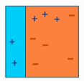
Adaboost Working: Step 01
Assign equal weights to each data point
Apply a decision stump to classify them as + (plus) and – (minus)
Decision stump (D1) has generated vertical plane at the left side to classify
Apply higher weights to incorrectly predicted three + (plus) and add another decision stump
Iteration 01

Slide 20
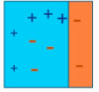
Adaboost Working: Step 02
Size of three incorrectly predicted + (plus) is made bigger as compared to rest of the data points
The second decision stump (D2) will try to predict them correctly
Now, vertical plane (D2) has classified three mis-classified + (plus) correctly
D2 has also caused mis-classification errors to three – (minus)
Iteration 02

Slide 21
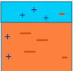
Adaboost Working: Step 03
D3 adds higher weights to three – (minus)
Horizontal line is generated to classify + (plus) and – (minus) based on higher weight of mis-classified observation
Iteration 03

Slide 22
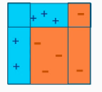
Adaboost Working: Step 04
D1, D2, and D3 are combined to form a strong prediction having complex rule as compared to individual weak learner
Final Classifier

Slide 23
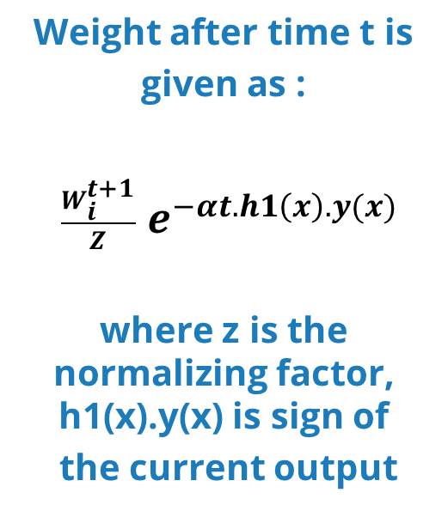

Adaboost Algorithm
STEP
STEP
STEP
STEP
1
2
3
4
Initially each data point is weighted equally with weight
𝑊𝑖 = 1/𝑛
where n is the number of samples
A classifier ‘H1’ is picked up that best classifies the data with minimal error rate
The weighing factor $α$ is dependent on errors ($ε_{t}$) caused by the H1 classifier
${ α}^{t}$ = $\frac{1}{2}$ ln $\frac{1−ε_{t}}{ε_{t}}$
Weight after time t is
given as :
$\frac{W_{i}^{t+1}}{Z}$ $e^{−αt.h1\left(x\right).y(x)}$
where z is the normalizing factor, h1(x).y(x) is sign of
the current output
Notes:
Trainer notes:
1. Explain the formulas

Slide 24
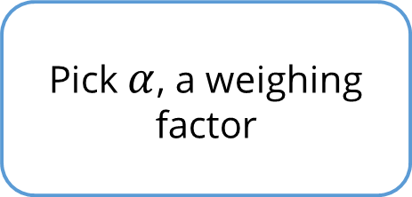

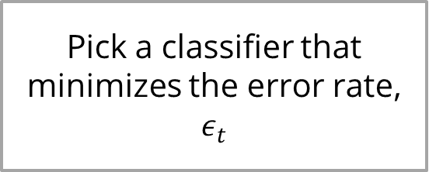
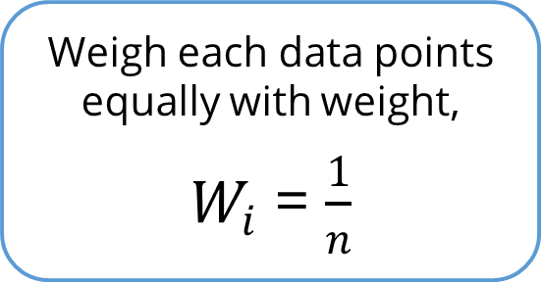
Adaboost Flowchart
Weigh each data points equally with weight,
$W_{i}$ = $\frac{1}{n}$
Pick $α$, a weighing factor
Pick a classifier that minimizes the error rate, $ε_{t}$
Calculate $W^{t+1}$
Notes:
Trainer notes:
1. Explain the flowchart

Slide 25
Gradient Boosting (GBM)
Gradient boosting involves three elements:
A loss function to be optimized
A weak learner to make predictions
2
An additive model to add
weak learners to minimize
the loss function
1
3
GBM minimizes the loss function (MSE) of a model by adding weak learners using a gradient descent procedure.

Slide 26
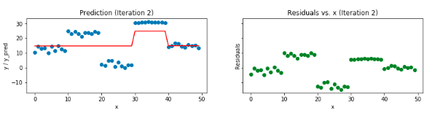
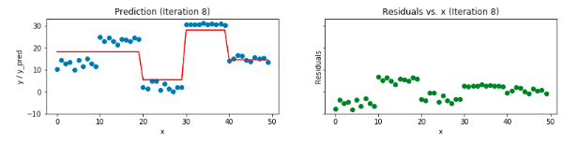
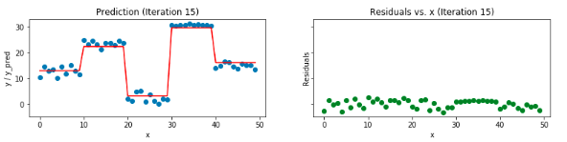
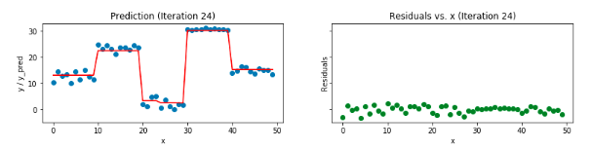
GBM Mechanism
01
GBM predicts the residuals or errors of prior models
and then sums them to make the final prediction
One weak learner is added at a time and existing weak learners in the model are left unchanged
02
One new weak learner is added at a time and
existing weak learners in the model left unchanged
03
GBM repetitively leverages the patterns in residuals
and strengthens a model with weak predictions
04
Modeling is stopped when residuals do
not have any pattern that can be modeled
04
Notes:
Trainer Notes:
1. Explain the GBM Mechanism

Slide 27
GBM Algorithm
Step 01 Fit a simple regression or classification model
Step 02 Calculate error residuals ( actual value - predicted value )
Step 03 Fit a new model on error residuals as target variable with same input variables
Step 04 Add the predicted residuals to the previous predictions
Step 05
Fit another model on residuals that are remaining and repeat steps 2
and 5 until model is overfit or the sum of residuals becomes constant
Notes:
Trainer Notes:
1. Give an overview of the steps

Slide 28


XGBoost
eXtreme Gradient Boosting is a library for developing fast and high-performance gradient boosting tree models.
eXtreme Gradient
Boosting
custom tree
building algorithm
Used for:
Classification
Regression
Ranking
With custom loss
functions
Interfaces for
Python and R,
can be executed
on YARN
XGBoost is extensively used in ML competitions as it is almost 10 times faster than other gradient boosting techniques
Notes:
Trainer Notes:
1. Explain how XGBoost is used in industry

Slide 29
XGBoost Parameters
1
General Parameters
Number of threads
3
2
Task Parameters
Booster Parameters
Objective
Evaluation metric
Step size
Regularization
Notes:
Trainer Notes:
1. Give an overview of the XGBoost parameters

Slide 30



XGBoost Library Features
XGBoost library features tools are built for the sole purpose of model performance and computational speed.
01
02
03
System
ALGORITHM
Models
Parallelization
Tree construction using all
CPU cores while training
Distributed Computing
Training very large models
using a cluster of machines
Cache Optimization
Data structures make best use of hardware
Sparse Aware
Automatic handling of missing data values
Block Structure
Supports the parallelization of tree construction
Continued Training
To boost an already fitted model on new data
Gradient Boosting
Gradient boosting machine algorithm including learning rate
Stochastic Gradient Boosting
Sub-sampling at the row, column and column per split levels
Regularized Gradient Boosting
With both L1 and L2 regularization
Notes:
Trainer Notes:
1. Explain the features which makes XGBoost a powerful library

Slide 31
General Parameters
General parameters guide the overall functioning of XGBoost
nthread
- Number of parallel threads
- If no value is entered, algorithm automatically detects the number of cores and runs on all the cores
booster
- gbtree: tree-based model
- gblinear: linear function
Silent [default =0]
- if set to 1, no running messages will be printed.
Hence, keep it ‘0’ as the messages might help in understanding the model
Notes:
Trainer notes:
Explain usage of these parameters based on the need

Slide 32
Booster Parameters
Booster parameters guide individual booster (Tree/Regression) at each step
Parameters for tree booster
eta
- Step size shrinkage is used in update to prevent overfitting
- Range in [0,1], default 0.3
gamma
- Minimum loss reduction required to make a split
- Range [0,∞ ], default 0
max_depth
- Maximum depth of a tree
- Range [1, ∞ ], default 6
min_child_weight - Minimum sum of instance weight needed in a child
- Range [0, ∞], default 1
Notes:
Trainer notes:
Explain usage of these parameters based on the need

Slide 33
Booster Parameters (Contd.)
Parameters for tree booster
max_delta_step
- Maximum delta step allowed in each tree's weight estimation
- Range in [0, ∞ ], default 0
subsample
- Subsample ratio of the training instance
- Range [0,1 ], default 1
Colsample_bytree
- Subsample ratio of columns when constructing each tree
- Range [0, 1 ], default 1
Notes:
Trainer notes:
Explain usage of these parameters based on the need

Slide 34
Booster Parameters (Contd.)
Parameters for Linear booster
lambda
- L2 regularization term on weights
- default 0
alpha
- L1 regularization term on weights
- default 0
Lambda_bias
- L2 regularization term on bias
- default 0
Notes:
Trainer notes:
Explain usage of these parameters based on the need

Slide 35
Task Parameters
Task parameters guide optimization objective to be calculated at each step
1. Objectives [default = reg:linear]
"binary:logistic": logistic regression for binary classification, output is probability not class
"multi:softmax": multiclass classification using the softmax objective, need to specify num_class
2. Evaluation Metric
"rmse"
"logloss"
"error"
"auc"
"merror"
"mlogloss"
i
https://xgboost.readthedocs.io/en/latest/parameter.html
Notes:
Trainer notes:
Explain usage of these parameters based on the need

Slide 36
Assisted Practice
Boosting
Duration: 15 mins.
Problem Statement: The Pima Indians Diabetes dataset has diagnostic measures like BMI, blood pressure of female patients of more than 21 years old.
Objective:
Classify whether the person is diabetic with maximum accuracy
Access: Click on the Labs tab on the left side panel of the LMS. Copy or note the username and password that are generated. Click on the Launch Lab button. On the page that appears, enter the username and password in the respective fields, and click Login.
Notes:
Trainer Notes:
Perform the above demo in python by downloading the pima_diabetes.csv dataset from the LMS.
Ask the learners to perform the same on their system simultaneously.

Slide 37
Unassisted Practice
Boosting
Duration: 20 mins.
Problem Statement: The Iris plant has 3 species : Iris Setosa, Iris Versicolour, Iris Virginica
One class is linearly separable from the other two whereas the latter are not linearly separable from each other.
Objective:
Import the iris dataset using sklearn
Build a classification model using AdaBoost and XGBoost
Compare accuracy of both the models
Access: Click on the Labs tab on the left side panel of the LMS. Copy or note the username and password that are generated. Click on the Launch Lab button. On the page that appears, enter the username and password in the respective fields, and click Login.
Notes:
Trainer Notes: Explain the following:
1. Ask the learners to perform the above demo by using sklearn library and importing the Iris dataset (in class) and help them, if needed.

Slide 38
Step 1: Data Import
iris = datasets.load_iris()
X = iris.data
y = iris.target
Code
from sklearn.ensemble import AdaBoostClassifier
from sklearn import datasets
from sklearn.model_selection import train_test_split
from sklearn import metrics
iris = datasets.load_iris()
X = iris.data
y = iris.target
iris = datasets.load_iris()
X = iris.data
y = iris.target
X_train, X_test, y_train, y_test = train_test_split(X, y, test_size=0.3)

Slide 39
Step 2: Classifier
Code
abc = AdaBoostClassifier(n_estimators=50, learning_rate=1)
model = abc.fit(X_train, y_train)
y_pred = model.predict(X_test)
print("Accuracy:",metrics.accuracy_score(y_test, y_pred))
from sklearn import svm
from xgboost import XGBClassifier
clf = XGBClassifier()
clf.fit(X_train, y_train)
y_pred2 = clf.predict(X_test)
print(metrics.accuracy_score(y_test, y_pred2))

Slide 40
Ensemble Learning
Topic 3: Model Selection

Slide 41

Model Evaluation
Models can be evaluated based on their measure of performance
Notes:
Trainer Notes:
1. Explain when to evaluate model performance

Slide 42


Assessing Model Performance
Train/Test Split
Cross Validation Split
Divide the training dataset
Train on the first training set
Test on the second set
Sets of train/test splits created
Accuracy for each set is checked
Results are averaged
Techniques to assess model performance
Notes:
Trainer Notes:
1. Explain how to choose the best model

Slide 43
Train/Test Split
Examples
-
+
-
-
+
-
-
-
-
+
+
+
+
-
-
+
Train
+
+
+
-
-
-
+
+
Hypothesis Space
Creating the training dataset
Notes:
Trainer Notes:
1. Explain the train/test split

Slide 44
Train/Test Split (Contd.)
Testing set
-
-
-
-
+
+
+
+
+
+
-
-
+
Hypothesis space H
Creating the testing dataset
Notes:
Trainer Notes:
1. Explain the train/test split

Slide 45
Train/Test Split (Contd.)
Testing set
-
+
+
-
+
+
+
Test
-
+
+
-
-
-
Hypothesis space H
Notes:
Trainer Notes:
1. Explain the train/test split

Slide 46
Train/Test Split (Contd.)
9/13 correct
Testing set
-
-
-
+
-
+
-
-
+
+
+
+
+
+
+
-
+
+
+
+
-
-
-
-
+
-
Hypothesis space H
Verifying the results
Notes:
Trainer Notes:
1. Explain the train/test split

Slide 47
Common Splitting Strategies
K-Fold Cross-Validation
Dataset
Train
Test
Leave-one-out
Identifying the Train/Test split ratio
Notes:
Trainer Notes:
1. Explain K-Fold cross validation

Slide 48
Common Splitting Strategies (Contd.)
K-Fold Cross-Validation
Leave-one-out
Notes:
Trainer Notes:
1. Explain Leave-one-out

Slide 49
Train/Test Split vs. Cross-Validation
Cross-validation
Train/Test Split
Runs K-times faster than K-fold cross-validation
Simpler to examine the detailed results of testing process
More accurate estimate of out-of-sample accuracy
More efficient use of data(every observation is used for both training and testing)
Notes:
Trainer Notes:
1. Explain the pros and cons

Slide 50
Assisted Practice
Cross-validation
Duration: 15 mins.
Problem Statement: Few learners have implemented random forest classifier on the Iris data but, better accuracy can be achieved using cross-validation sampling technique.
Objective:
Generate the random forest using cross validation splitting technique.
Determine the accuracy such that it is the average of all the resultant accuracies.
Access: Click on the Labs tab on the left side panel of the LMS. Copy or note the username and password that are generated. Click on the Launch Lab button. On the page that appears, enter the username and password in the respective fields, and click Login.
Notes:
Trainer Notes:
Perform the above demo in python using sklearn Iris dataset from the LMS.
Ask the learners to perform the same on their system simultaneously.

Slide 51
Unassisted Practice
Cross-Validation
Duration: 20 mins.
Problem Statement: Mtcars, an automobile company in Chambersburg, United States has recorded the production of its cars within a dataset. In order to classify cars, the company has come up with two classification models (KNN and Logistic Regression).
Objective: Perform a model selection between the above two models using the sampling technique as 10-fold cross- validation.
Note: This practice is not graded. It is only intended for you to apply the knowledge you have gained to solve real-world problems.
Access: Click on the Labs tab on the left side panel of the LMS. Copy or note the username and password that are generated. Click on the Launch Lab button. On the page that appears, enter the username and password in the respective fields, and click Login.
Notes:
Trainer Notes: Explain the following:
1. Ask the learners to perform the above demo by using Mtcars dataset(in class) and help them, if needed.

Slide 52
Defining a 10-Fold KNN Model
Define a 10-fold KNN model and calculate the average of each accuracy matrix obtained.
Code
from sklearn.cross_validation import cross_val_score
knn = KNeighborsClassifier(n_neighbors=4)
print(cross_val_score(knn, x, y, cv=10, scoring ='accuracy').mean())
The accuracy came out to be 56.66%.

Slide 53
Defining a 10-Fold Logistic Regression Model
Define a 10-fold Logistic Regression model and calculate the average of each accuracy matrix obtained.
Code
from sklearn.linear_model import LogisticRegression
logreg = LogisticRegression()
print (cross_val_score(logreg, x, y, cv=10, scoring = 'accuracy').mean())
The accuracy came out to be 28.33%.
Hence, you can infer that KNN model for the task is better as compared to Logistic Regression model.

Slide 54
Now, you are able to:
Explain ensemble learning
Evaluate performance of boosting models

Slide 55

© Simplilearn. All rights reserved.

Slide 56
Which of the following is not an ensemble method?
1
Decision Tree
Random Forest
Adaboost
None of the above
© Simplilearn. All rights reserved.

Slide 57
Which of the following is not an ensemble method?
1
Decision Tree
Random Forest
Adaboost
None of the above
a. Decision Tree
In decision tree, single tree is built and no ensembling is required.

Slide 58
Some of the advantages of XGBoost include:
2
Parallelization
Handling missing values
Support for multiple GBM models
All of the above
© Simplilearn. All rights reserved.

Slide 59
Some of the advantages of XGBoost include:
2
Parallelization
Handling missing values
Support for multiple GBM models
All of the above
d. All of the above
XGBoost is scalable and has accurate implementation of gradient boosting machines.
It has proven to push the limits of computing power for boosted trees.

Slide 60
Lesson-End Project
Car Evaluation Database
Duration: 30 mins
Problem Statement: Used car market has significantly grown in recent times with clients ranging from used car dealers and buyers.You are provided with a car evaluation dataset that has features like price, doors, safety, and so on.
You are required to create a robust model that allows stakeholders to predict the condition of a used vehicle.
Objective:
Predict the condition of a vehicle based on features
Plot the most import features
Train multiple classifiers and compare the accuracy
Evaluate XGBoost model with K-fold cross-validation
Access: Click on the Labs tab on the left side panel of the LMS. Copy or note the username and password that are generated. Click on the Launch Lab button. On the page that appears, enter the username and password in the respective fields, and click Login.
Notes:
Trainer Notes: Describe the project to the learners and instruct them to perform it after the lesson.
https://archive.ics.uci.edu/ml/machine-learning-databases/car/car.names

Slide 61
© Simplilearn. All rights reserved.

